Slide 1
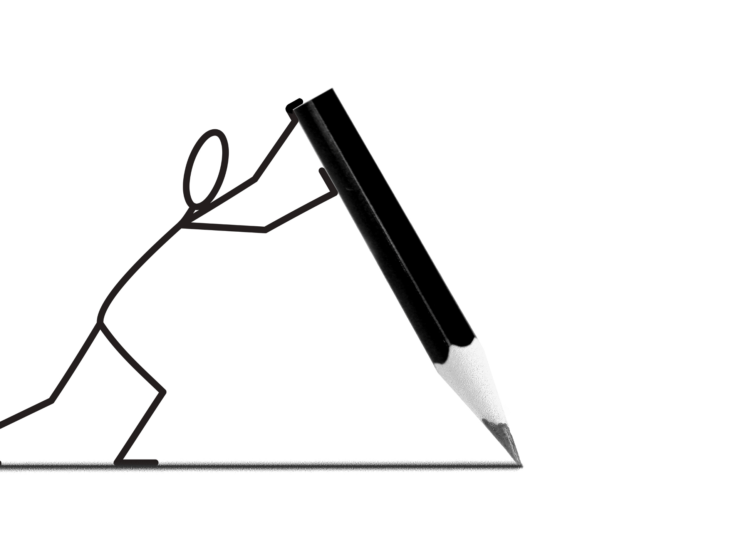
Basics of Technical Paper Writing
“Start writing, no matter what. The water does not flow until the faucet is turned on.”
- Louis L ’Amour
Bitty S Varghese
Alumna SBCE
M.TECH 2014-2016 Batch

Slide 2

Agenda
Introduction
General Structure
Plagiarism
Journals vs
Conferences
Paper Writing : LaTeX
Notes:
© Copyright PresentationGO.com – The free PowerPoint and Google Slides template library

Slide 3
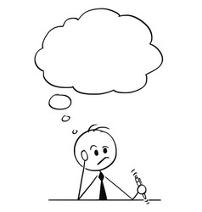
Technical / Research Writing…!!
“Publication has been extended far beyond our present ability to make real use of the record.” — Vannevar Bush
Academic writing:
are devoted to topics and questions that are of interest to the academic community.
present with depth, logic, unity clarity, grammatically structured and a sound argument.
Audience:
Referees
journal readers
still, you are learner.
are writings by scholars for other scholars.
General audiences
Source:(Odegaard Writing & Research Center, n.d)

Slide 4

General Structure
Title
Abstract & Keywords
Introduction
Background/ Related Work/Literature Review
Method & Materials
Results and Discussion
Conclusion/ Summary
About the Author (Optional)
Acknowledgement (Optional)
References/ Bibliography

Slide 5

Title
First introduction to readers / reviewers
Convey the main topics of the study
Highlight the importance of the research
Be concise
Entice readers
Source:(Springer Nature, 2021)

Slide 6
Abstract
An executive summary of the content
A time-saving reference
Roadmap to the most important parts of the written content
Source:(Springer Nature, 2021)

Slide 7
Abstract
Contents
Purpose
Methods
Scope
Results
Conclusions
Recommendations
Source:(HSRW Study Material, 2018)

Slide 8

Abstract
Informative
Ranging from a paragraph to one or two pages
Descriptive
Allows the reader to decide if they want to read the report
Typically 10% of article or less
Abstract should be very short
Typically under 100 words
Introduces subject to the readers to read the report to learn the study results
Source:(HSRW Study Material, 2018)

Slide 9
Abstract : Tips
Verbs in the active voice and present tense
No terms, abbreviations, or symbols unfamiliar to the reader
No new information
No evaluative comments such as:
"The findings represent the best possible combination of …”
Source: (HSRW Study Material, 2018)

Slide 10
Keywords
Represent the content
Be specific to your field or sub-field
Source:(Andrea Hayward, 2018)

Slide 11
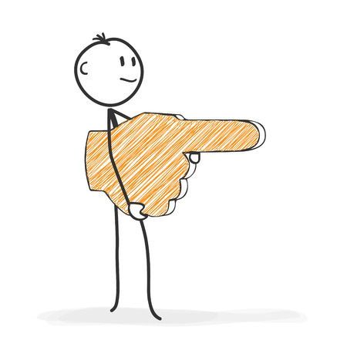
Introduction
Motivation
Purpose
Scope
Research Questions
Structure of the Paper

Slide 12
Background/Related work/Literature review
Background
Related Work/Literature Review
Meaning: The context of the study
Aim: For highlighting the significance of the study
Content: Overview of the topic in context and narrowing it down to the problem at hand.
Size: Compact
Meaning: Critical analysis of existing literature
Aim: For evaluating the progress of knowledge in the field of study
Content: Aids in identifying the gaps in literature that motivated the study
Size: Comprehensive
Source: (Andrea Hayward, 2018)
Notes:
© Copyright PresentationGO.com – The free PowerPoint and Google Slides template library

Slide 13

Materials and Methods
Interview
Observation
Experiment
Modelling
Questionnaire
Working with sources

Slide 14





Materials and Methods
Make good use of the subheading
Use past tense while describing
Explain new methods in depth
Concisely brief established methods by reference
Provide all statistical tests and the parameters
01
02
03
04
05
Notes:
© Copyright PresentationGO.com – The free PowerPoint template library

Slide 15
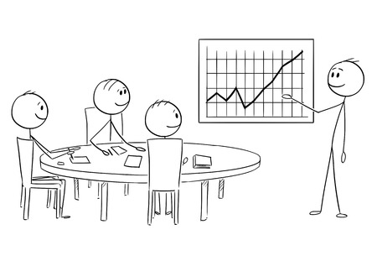
Results and Discussion
Results: refer to direct answers to your research questions that you generate from the data.
Discussion is about interpreting your study results.
In discussion, relate the study findings to previous studies and contextualize the contribution of the study.
Source: (Liqaa Habeb Al-Obaydi, 2017)

Slide 16

Conclusion/Summary
 | Summary | Conclusion
Meaning | Refers to the concise statement or presentation of the main points of a text or research | Provides a final answer to the research question(s)
Purpose | To outline the key features | It synthesizes and wraps up the topic by providing a supporting justification
Size | 5-15 % of the original material | Only 10%
Reviews | Central ideas | Implications, recommendations, findings, future scope and lessons learned
Ideas & Criticism | No | Yes
Source: (Source: IEREK, 2018; IEEE Communications Society, 2021)

Slide 17

List of References / Bibliography
Reference List : sources cited in-text
APA citations, AMA citations, and MLA citations.
Bibliography : all sources used to generate the ideas
Chicago citations and Oxford citations
Sources:(Griffith University, n.d; Anonymous, 2017)

Slide 18
APA citation vs MLA citation
APA (American Psychological Association)
Author’s Name. Year of publication in parenthesis. Title. Place of publication: Publisher
MLA (Modern Language Association)
Author’s Name. Title. Place of publication: Publisher, year

Slide 19
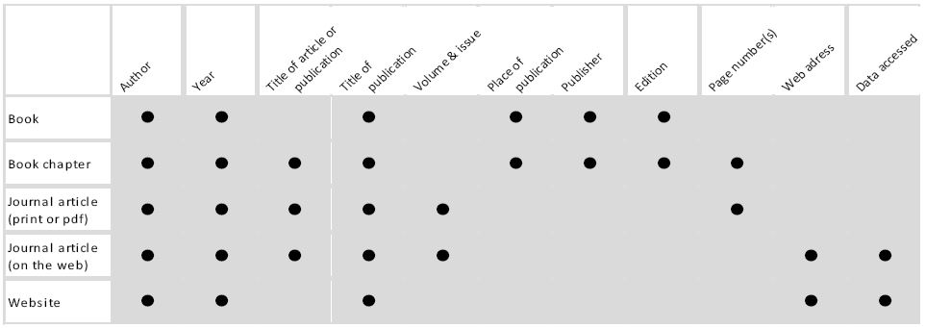
References
Source: (Academic Writing Manual, 2020)

Slide 20
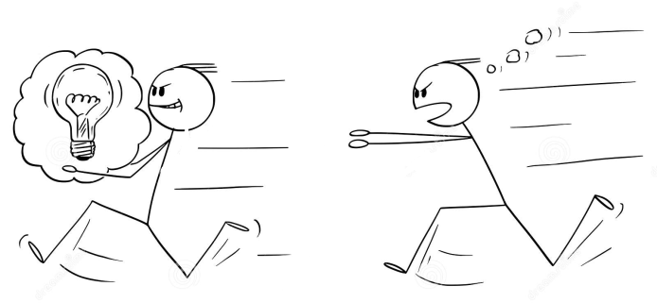
Plagiarism
A scientific misconduct
“The act of taking credit or attempting to take credit of someone else’s work by using or closely imitating the work and representing it as one's own original work .”
Accurately cite and reference by acknowledging ideas and work of others
Source: (Academic Writing Manual, 2020)

Slide 21
Plagiarism-free (HELP)
Hold
Always keep tight hold of all sources
Employ
Employ a plagiarism checker
List
List the name of the original author
Paraphrase
Paraphrase or cite all sources
Notes:
© Copyright PresentationGO.com – The free PowerPoint and Google Slides template library

Slide 22
Journals vs Conferences
 | Journal Paper | Conference Paper
Definition | Article in a periodical publication that focuses on a particular discipline | Article submitted to a venue where scholars, researchers, professors, and academics meet to discuss research and developments in a particular field
Size | Broad and detailed | Short and concise
Acceptance Period | Flexible and longer time period | Fixed and short time period
Published at | Open or closed access journal | Conference proceedings book or online proceedings repository
Top Journals e.g., IEEE, Springer, Journal of the ACM, SIAM Journal on Computing etc.
Source: (Source: IEREK, 2018; IEEE Communications Society, 2021)

Slide 23

LaTeX – Smart Engineered System for document preparation system
Uniformity of style
Bibliographic support
Advanced structuring options
Reference tracking
Hi-level extensibility features
“You take care of writing, and we’ll take care of presentation.”
Source:(Research Science Institute, 2015)
Notes:
© Copyright PresentationGO.com – The free PowerPoint and Google Slides template library

Slide 24
Paper writing using LaTeX
Install “basic-miktex-20.6.29-x64” for Windows OS from https://miktex.org/download
LaTeX online equation editor https://www.codecogs.com/latex/eqneditor.php
IEEE LaTeX template https://template-selector.ieee.org/secure/templateSelector/publicationType

Slide 25
LaTeX: Main parts
Preamble
Main part
Bibliography
NB: Include comments in simple language

Slide 26
Levels
1. Chapter
1. 1 Section
1.1.1 Subsection
1.1.1.1 Subsubsection
Paragraph
Subparagraph

Slide 27
Packages : MikTeX
\usepackage{}
times : Time New Roman Font package
graphicx : Images package
\graphicpath{./images/}
caption, subcaption : Multiimages
algorithm , algopseudocode : Algorithm package
listing : Code listing package
xcolor : Different colors for keywords, constants, variables
\definecolor
biblatex : Bibliography style package
ragged2e : Make the content justify aligned
tabularx, multirow : Tables package
babel : Language package
[english] : for English language spell-checker
setspacing : Line spacing package
\onehalfspacing

Slide 28
Bibliography (.bib)
@TYPE{ID,
author = “”,
title = “”,
publisher = “”,
…
}
TYPE
ARTICLE, PHDTHESIS, THESIS, BOOK, INCOLLECTION, ONLINE...
ID for citation

Slide 29
Getting Help
https://www.overleaf.com/learn
https://ctan.org/topic/latex-doc?lang=en
http://www.docs.is.ed.ac.uk/skills/documents/3722/3722-2014.pdf
https://en.wikibooks.org/wiki/LaTeX/Creating_Package_Documentation
“ Google is always the best friend you have!”

Slide 30
General Tips
Write inside-out
Make the reference list in parallel
Draft it first and re-read and re-write
Don’t use personal pronouns

Slide 31
References
Al-Obaydi, Liqaa Habeb, 2017, What is the difference between results, discussion, and conclusions in writing a research paper?, URL: https://www.researchgate.net/post/What-is-the-difference-between-results-discussion-and-conclusions-in-writing-a-research-paper [Accessed on: 23.04.2021]
Griffith University, n.d, What is the difference between a reference list and a bibliography?, URL: https://studenthelp.secure.griffith.edu.au/app/answers/detail/a_id/1676/~/what-is-the-difference-between-a-reference-list-and-a-bibliography%3F [Accessed on: 23.04.2021]
Hayward, Andrea , 2018, INFOGRAPHIC: 6 Differences between study background and literature review, URL: https://www.editage.com/insights/6-differences-between-a-study-background-and-a-literature-review [Accessed on: 19.04.2021]
IEEE Communications Society, 2021, Conference Paper Versus Journal Paper, URL: https://www.comsoc.org/publications/journals/conference-paper-versus-journal-paper [Accessed on: 22.04.2021]
IEREK, 2018, The Difference between a Conference Paper and a Journal Paper, URL: https://www.ierek.com/news/index.php/2018/05/23/difference-conference-paper-journal-paper/ [Accessed on: 22.04.2021]
Nature Education, 2014, Scientific Papers , URL: https://www.nature.com/scitable/topicpage/scientific-papers-13815490/ [Accessed on: 23.04.2021]
Odegaard Writing & Research Center, n.d, What is an Academic Paper? ,URL: https://depts.washington.edu/owrc/Handouts/What%20is%20an%20Academic%20Paper.pdf [Accessed on: 22.04.2021]
Research Science Institute, Massachusetts Institute of Technology , 2015, Introduction to LATEX: Writing papers the right way, URL: https://web.mit.edu/rsi/www/pdfs/new-latex.pdf [Accessed on: 23.04.2021]
Springer Nature, 2021, Title, Abstract and Keywords , URL: https://www.springer.com/gp/authors-editors/authorandreviewertutorials/writing-a-journal-manuscript/title-abstract-and-keywords/10285522 [Accessed on: 19.04.2021]
Surbhi S, 2020, Difference Between Summary and Conclusion, URL: https://keydifferences.com/difference-between-summary-and-conclusion.html [Accessed on: 23.04.2021]

Slide 32


